Slide 1


Green Pace
Security Policy Presentation
Developer: David Varella

Slide 2

OVERVIEW: DEFENSE IN DEPTH
Security policies describe how companies plan to protect their assets. Our policy describes principles and standards that can help a team securely code software.
Defense-in-Depth uses numerous security “layers” to protect assets, so if one defense is compromised, other defenses exist to prevent threats.
This policy describes many security measures that can be used in this multi-layer strategy and tells our team what they need to focus on to create a secure system.

Slide 3
THREATS MATRIX
Our ten standards have varying threat levels and have been organized based on a combination of severity, likelihood, remediation cost and priority. Depending on these levels for each standard, they can be averaged out to create our threat matrix.
The bottom left column is the lowest priority, the bottom right column and upper left columns are mid-priority, and the upper right column is the highest priority.
Many automation tools, such as CodeSonar, Astree, and Parasoft C/C++test can find multiple types of threats with vulnerability scanning.
Automated tests can check for inconsistencies and errors.
Throughout the entire software development life cycle, automation can be used to find threats, and to save the team time with repetitive tasks.
Likely STD-004-CPP | Priority STD-002-CPP STD-003-CPP STD-005-CPP STD-008-CPP STD-010-CPP
Low priority STD-007-CPP | Unlikely STD-001-CPP STD-006-CPP STD-009-CPP

Slide 4
10 PRINCIPLES
Validate Input Data
Data Value – Enforce limits on integer values originating from tainted sources.
SQL Injection
Heed Compiler Warnings
Data Type – Include the appropriate type info in function declarators.
Assertions
Containers
Architect and Design for Security Policies
String Correctness
Keep it Simple
String Correctness
Memory Protection
Dead Code
Pointer Arithmetic
5. Default Deny
SQL Injection
6. Adhere to the Principle of Least Privilege
7. Sanitize Data Sent to Other Systems
Data Value – Enforce limits on integer values originating from tainted sources.
8.Practice Defense In Depth
SQL Injection
9. Use Effective Quality Assurance Techniques
Memory Protection
Assertions
Exceptions
Containers
Pointer Arithmetic
10. Adopt a Secure Coding Standard
Exceptions

Slide 5
CODING STANDARDS
To rank the coding standards, we can use our risk assessment chart, which includes the severity, likelihood, remediation cost, priority and level for each standard. From highest to lowest threat level, these are our standards:
STD-002-CPP: Data Value: Enforce limits on integer values from tainted sources.
STD-010-CPP: Pointer Arithmetic: Ensure pointer arithmetic is used correctly.
STD-008-CPP: Containers: Use valid integer ranges.
STD-005-CPP: Memory Protection: Allocate and free memory in the same module, at the same level of abstraction.
STD-003-CPP: String Correctness: Do not inadvertently truncate a string.
STD-004-CPP: SQL Injection: Exclude user input from format strings.
STD-007-CPP: Exceptions: Handle all exceptions.
STD-006-CPP: Assertions: Use a static assertion to test value of constant expressions.
STD-001-CPP: Data Type: Include the appropriate type info in function declarators.
STD-009-CPP: Dead Code: Detect and remove code with no effect or never executed

Slide 6
ENCRYPTION POLICIES
Encryption in rest uses algorithms such as the Advanced Encryption Standard (AES) to encode data on devices such as hard drives or databases to protect it. This encrypted data can only be decrypted with a key and is used to keep information confidential. Encryption scrambles the data into ciphertext, which is unreadable unless decoded. Without the key, attackers cannot use the data, even if they obtain the data.
Encryption at flight is used for data moving over networks, such as open networks, HTTP connections, public clouds and cell phones. This encryption requires the encryption of the data, and decryption on an authorized user’s side. Both require a unique key to authorize access of the data.
Encryption in use is also known as end-to-end encryption, and takes place while files are being accessed and used. Examples include databases, open files, and RAM data. This type of encryption encrypts data throughout the life cycle of the data and should be used before the data is even accessed. To decrypt this data, authentication mechanisms should be implemented, and should also follow the principle of least privilege.

Slide 7
TRIPLE-A POLICIES
Authentication: This involves identifying a user with credentials such as a username and password. Each user has a unique set of criteria to gain access, and the Triple-A server compares user-input to a database of credentials and will only give the user access if their credentials match a user in the database. Using authentication prevents unauthorized users and malicious users from accessing the network, database, and information.
Authorization: Users must be authorized to determine what activities, resources, and services they are permitted to use. Various levels of authorization should exist to prevent lower-level users from higher up commands. Using authorization can prevent unwanted changes to a database, access of files, creation and deletion of users/files, and data leak.
Accounting refers to the resources and files a specific user has accessed, and which commands they executed. After authorization, a user's activity can be monitored and logged for viewing by admins. Accounting can be used for authorization control, billing analysis, and resource utilization activities.

Slide 8
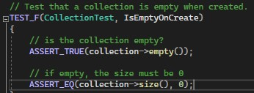
Unit Testing
STD-008-CPP: Containers: Use valid integer ranges.
Create a test that asserts a collection is empty on creation:
Results:

Slide 9
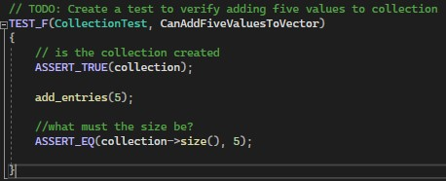
Unit Testing
STD-008-CPP: Containers: Use valid integer ranges.
Create a test to verify adding five values to collection.
Results:

Slide 10
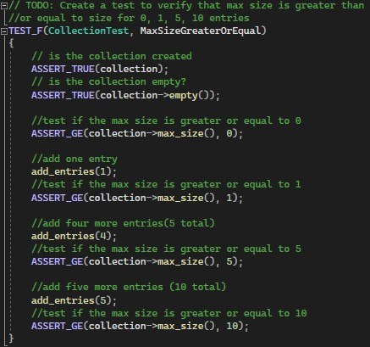
Unit Testing
STD-008-CPP: Containers: Use valid integer ranges.
Create a test to verify the max size is greater than 0,1,5,10:
Results:

Slide 11
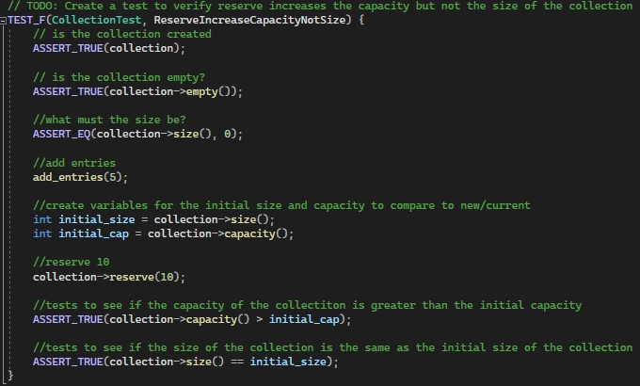
Unit Testing
STD-008-CPP: Containers: Use valid integer ranges.
Create a test to verify reserve increases capacity but not the size:
Results:

Slide 12
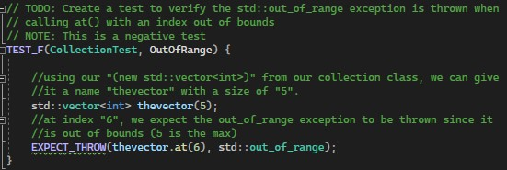
Unit Testing
STD-008-CPP: Containers: Use valid integer ranges.
Create a test to verify the std::out_of_range exception is thrown:
Results:

Slide 13

AUTOMATION SUMMARY

Slide 14
TOOLS
DevSecOps is a combination between DevOps and security practices throughout the entire software development life cycle. The goal is to automate security throughout the life cycle. The DevSecOps methodology combines development, security, and operations to produce a secure and reliable product, along with automating parts of development, testing, deployment along with the maintenance of the software.
In the ‘Assess and plan’ stage, automation is minimal, as the team is conducting analyses, backlog, etc.
The ‘Design’ stage includes code reviews, static code analysis, and a test-driven design to help build more secure code. Static code analysis may be automated using various tools, which tests the code against coding rules. Static code analysis attempts to find weaknesses in the code that may end up as vulnerabilities.
Next, in the ‘Build’ stage, automated analysis and testing is executed. Unit testing and static application software testing occur. Dependencies are installed, which may include vulnerabilities and exploits, which should be reviewed and tested for using automation.
‘Verify and test’ includes automated vulnerability scanning, as well as dynamic application security testing (DAST) to detect authorization and authentication.
The ‘Transition and health check’ stage includes security settings, deployment, and penetration tests. These should also be automated. This stage also concerns the principle of lease privilege.
‘Monitor and detect’ includes log collection, detection, event alerting, and can also be automated using various tools.
‘Respond’ stage includes zero-day vulnerability checks and monitoring the infrastructure.
‘Maintain and stabilize’ includes monitoring for abnormalities, and tools to automate this monitoring in real time are extremely important to spot exploits.

Slide 15
RISKS AND BENEFITS
From the beginning of development, software is always at risk of being exposed to vulnerabilities, bugs, and errors, all of which can expose the software and data of consumers and the application owner. This can lead to lost data, financial burden, and a bad reputation for the owner of the application. Waiting to include security in coding leaves the application having an “open door” for intruders, and by the time the developers decide to include security, it may already be too late, and a breach may have occurred.
During the planning stage, software design requirements should be established, which can benefit the company and prevent threats if followed. Coding standards should be enforced, also, which can detect and prevent threats.
Also, securing the application with a firewall and using antivirus software on all devices accessing the developing code can also benefit the company, securing or limiting access to the network, removing/preventing malware, etc.
Manual and automated code reviews and tests throughout the SDLC can prevent threats. There are numerous tools to scan for vulnerabilities, and automation can be used to save time and money.

Slide 16
RECOMMENDATIONS
After performing a gap analysis of our security policy, we have identified gaps that may require improvement now and/or in the future. These gaps may reduce the overall security we have set in place, as there are vulnerabilities to be addressed.
Worker termination – There is currently no standard on employee termination. Requiring employees exit in an orderly manner is necessary, which should include returning all equipment they may have, and removal of any access (ISO/IEC 1779:2005(E)).
Confidentiality agreement – Preventing data that our employees may discuss at work is important and should not be discussed outside of work. A policy to prevent this should be put in place (ISO/IEC 1779:2005(E)).
Asset management – Assets should be accounted for, clearly identified, and an inventory of assets should be maintained and represent each assets importance. Also, assets should be owned by a designated part of the company to ensure assets are classified and restricted if necessary (ISO/IEC 1779:2005(E)).
User Password Management – Users should sign a statement to keep passwords confidential, and group passwords should remain with only group members (ISO/IEC 1779:2005(E)).

Slide 17
CONCLUSIONS
After performing a gap analysis of our security policy, we have identified standards that should be adopted to prevent future issues. A few of these standards include:
MSC41-C. Never hard code sensitive information. Hard coding info such as passwords and encryption keys can expose this data to attackers. Anyone with access to files can examine them for strings. This also increases the need to make changes in the code, such as changing a hard coded password in a deployed program requiring a patch.
MEM30-C. Do not access freed memory. Evaluating a pointer into memory that has been deallocated by a memory management function is undefined behavior, and will lead to dangling pointers, which may result in exploitable vulnerabilities.
FIO21-C. Do not create temporary files in shared directories. Programmers often create temp. files in shared directories. These are often created with a well-known name, which attackers can easily hijack or manipulate these files.
MSC00-C. Compile cleanly at high warning levels. Use the highest warning level available for the compiler and eliminate warnings by modifying the code.

Slide 18
REFERENCES
IEC, I. (2005). International Standard ISO/IEC 27002. International Organization for Standardization and International Electrotechnical Commission. https://bcc.portal.gov.bd/sites/default/files/files/bcc.portal.gov.bd/page/adeaf3e5_cc55_4222_8767_f26bcaec3f70/ISO_IEC_27002.pdf
The 12 elements of an information security policy. Exabeam. (2023, February 27). https://www.exabeam.com/explainers/information-security/the-12-elements-of-an-information-security-policy/#:~:text=To%20be%20effective%2C%20an%20information,business%20needs%20and%20evolving%20threats
SEI CERT C Coding Standard. SEI CERT C Coding Standard - SEI CERT C Coding Standard - Confluence. (n.d.). https://wiki.sei.cmu.edu/confluence/display/c/SEI+CERT+C+Coding+Standard
How to perform an information security gap analysis. SecurityScorecard. (2023, July 26). https://securityscorecard.com/blog/how-to-perform-an-information-security-gap-analysis/#:~:text=To%20uncover%20gaps%20and%20vulnerabilities,and%20your%20overall%20security%20effectiveness.

